Slide 1

DATA MINING PROJECT AIRLINES CUSTOMER SATISFACTION SYSTEM
PRIYANKA KUMARI(32)
RIYA TYAGI(60)

Slide 2
Timeline:
Problem Statement
Dataset Overview
Data Preprocessing
Exploratory Data Analysis (EDA)
Feature Engineering
Model Selection
Relevant Research Papers
Conclusion

Slide 3
Problem Statement
The airline industry faces the challenge of maintaining customer satisfaction in a dynamic market where passengers’ service expectations are constantly evolving. Airlines must identify which service features are most valued by passengers to improve satisfaction and loyalty effectively to maximize their profit.
Objective
The project aims to:
1.Identify critical service attributes that influence passenger satisfaction. Build a robust predictive model to classify passengers as "satisfied" or "dissatisfied/neutral" based on service features.
2.Provide actionable insights to airline management on which service aspects to prioritize for enhancing customer satisfaction.

Slide 4
Dataset Overview
Dataset Used: Airline Passenger Satisfaction from Kaggle [Link]
Context: This dataset contains an airline passenger satisfaction survey. What factors are highly correlated to a satisfied (or dissatisfied) passenger?
Content:
1.Gender: Gender of the passengers (Female, Male)
2.Customer Type: The customer type (Loyal customer, disloyal customer)
3.Age: The actual age of the passengers
4.Type of Travel: Purpose of the flight of the passengers (Personal Travel, Business Travel)
5.Class: Travel class in the plane of the passengers (Business, Eco, Eco Plus)
6.Flight distance: The flight distance of this journey

Slide 5
7.Inflight wifi service: Satisfaction level of the inflight wifi service
8.Departure/Arrival time convenient: Satisfaction level of Departure/Arrival time convenient
9.Ease of Online booking: Satisfaction level of online booking
10.Gate location: Satisfaction level of Gate location
11.Food and drink: Satisfaction level of Food and drink
12.Online boarding: Satisfaction level of online boarding
13.Seat comfort: Satisfaction level of Seat comfort
14.Inflight entertainment: Satisfaction level of inflight entertainment
15.On-board service: Satisfaction level of On-board service
16.Leg room service: Satisfaction level of Leg room service
17.Baggage handling: Satisfaction level of baggage handling

Slide 6
18.Check-in service: Satisfaction level of Check-in service
19.Inflight service: Satisfaction level of inflight service
20.Cleanliness: Satisfaction level of Cleanliness
21.Departure Delay in Minutes: Minutes delayed when departure
22.Arrival Delay in Minutes: Minutes delayed when Arrival
23.Satisfaction: Airline satisfaction level(Satisfaction, neutral or dissatisfaction)

Slide 7
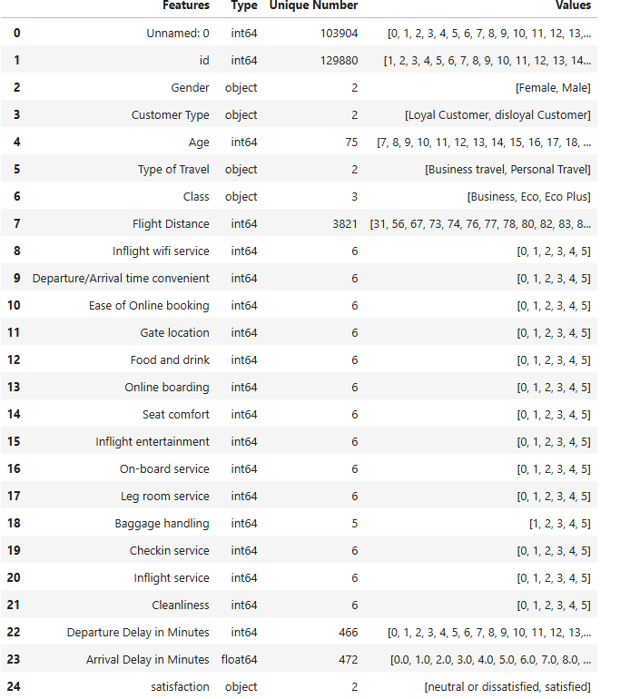

No. Of Rows/Records in Dataset: 129880
No. Of Columns/Attributes:25

Slide 8
Data Preprocessing
Handling Missing Values: Missing values in 'Arrival Delay in Minutes' were filled with the median due to their skewed distribution
Removing Unnecessary Columns: Non-predictive columns like 'Unnamed: 0' and 'id' were removed. 'Unnamed: 0' an index column, and 'id' is typically a unique identifier not useful for analysis.
Outlier Handling: Extreme values in continuous features like 'Flight Distance,' 'Departure Delay in Minutes,' and 'Arrival Delay in Minutes' were detected and removed.

Slide 9
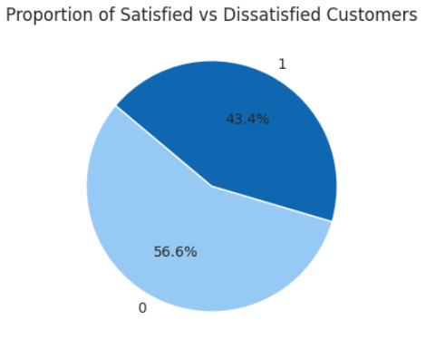
Exploratory Data Analysis (EDA)
The proportions of 'satisfied' and 'dissatisfied' customers, revealing an approximately balanced distribution with 43% satisfied.
Insights from the next graph:
Class: Business Class passengers show higher satisfaction; Economy classes have more dissatisfaction.
Gender: Both males and females lean towards dissatisfaction.
Customer Type: Disloyal customers are mostly dissatisfied; loyal customers are more balanced.
Type of Travel: Business travelers are generally more satisfied; personal travelers show more dissatisfaction.
Age: Older passengers tend to be more satisfied, while younger passengers have mixed satisfaction.

Slide 10
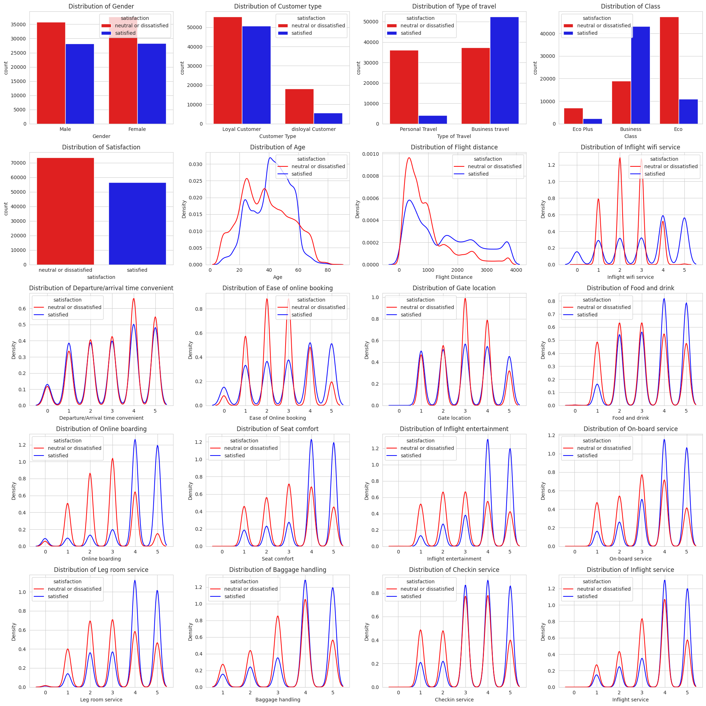
Some other insights from the graph:
Flight Distance: Longer flights correlate with higher dissatisfaction.
Inflight Wi-Fi Service: Poor Wi-Fi ratings lead to dissatisfaction.
Seat Comfort: Low seat comfort is a strong factor in dissatisfaction.
Food and Drink: Poor food ratings contribute to dissatisfaction.
Online Booking: Difficult booking processes increase dissatisfaction.
Inflight Entertainment: Limited entertainment options result in dissatisfaction

Slide 11
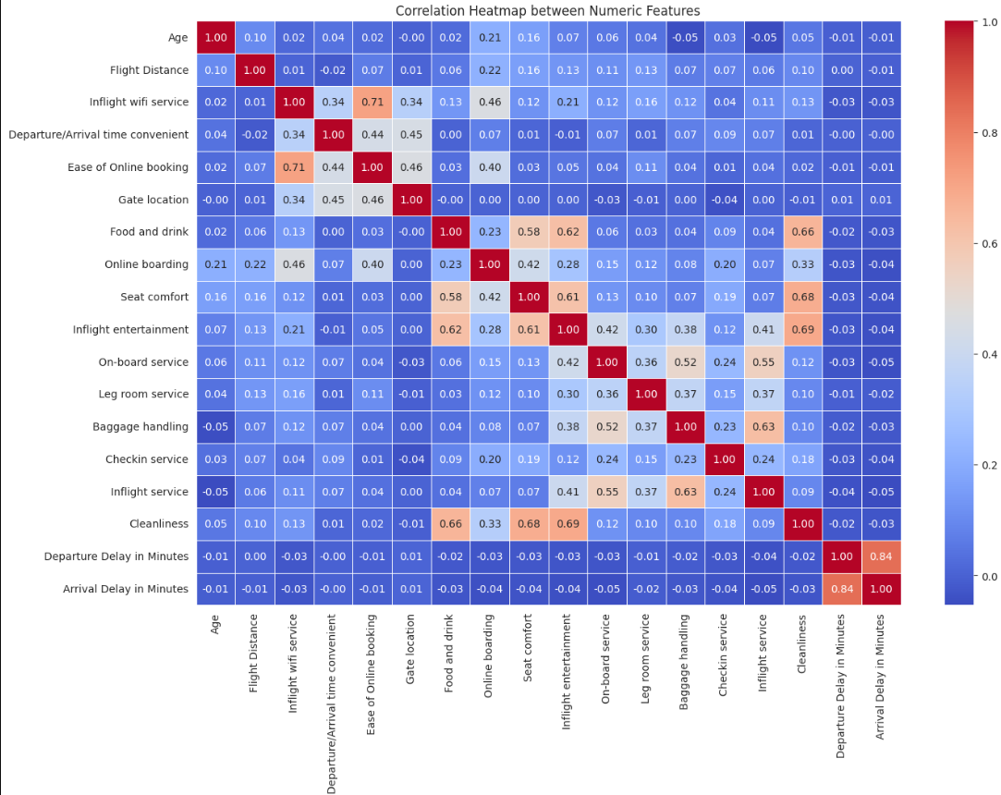
Feature Engineering
Encoding Categorical Variables: Categorical features like 'Gender,' 'Customer Type',' Gender' and 'Satisfaction' were label-encoded for compatibility with machine learning models.
Correlation Analysis: Pearson correlation was calculated to identify highly correlated features.
Check-in Service and Inflight Service: High correlation; passengers who rate one highly tend to rate the other highly as well.
Departure and Arrival Delays: High correlation; longer departure delays often lead to longer arrival delays.

Slide 12
Model
In this project we used 3 model to conduct a comparative study, aiming to analyze difference in accuracy. We assessed the models based on their accuracy, precision, recall score, f score. Models that we have used are:
Logistic Regression
Decision Tree
Random Forest

Slide 13
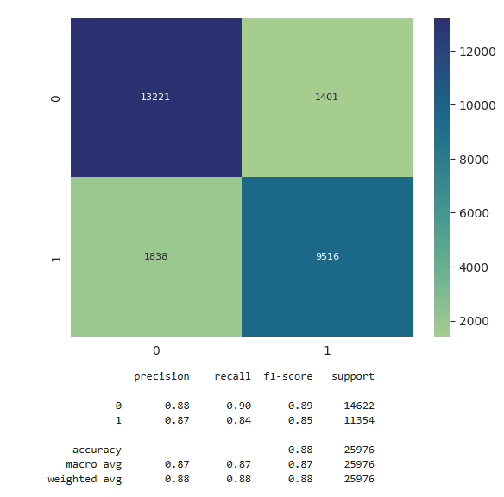
Logistic Regression
Definition: Logistic Regression is a statistical model used for binary classification tasks, where the outcome can be one of two classes (e.g., satisfied vs. dissatisfied).
Logistic Regression achieved an accuracy of 87.5%, indicating moderate success

Slide 14
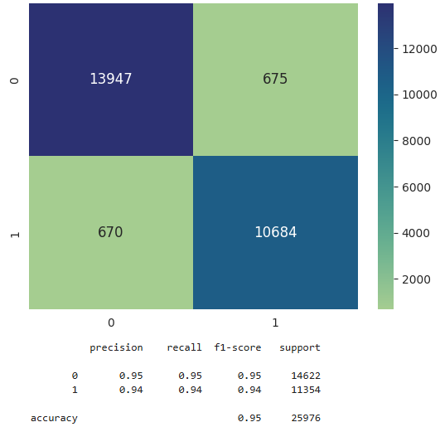
Decision Tree
Definition: A Decision Tree is a non-linear model that splits data into subsets based on feature values to make predictions. Each split, represented by a node, is chosen to maximize information gain or minimize impurity (e.g., using Gini or entropy). This process continues until it reaches a predefined depth or pure classification in each subset.
The Decision Tree model achieved an accuracy of 94.9%, a substantial improvement over Logistic Regression. This high accuracy suggests that non-linear relationships between features, such as combinations of flight class, loyalty, and service ratings, significantly influence satisfaction.

Slide 15

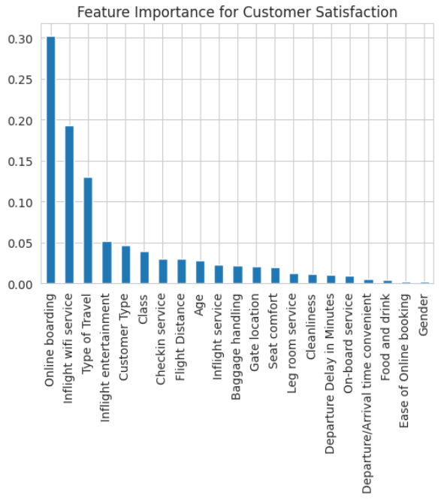

The Decision Tree’s feature importance scores highlight Online Boarding, Inflight Wi-Fi Service, and Type of Travel customer type, and entertainment are the features that most significantly influence customer satisfaction. Therefore, the company should pay attention to these factors.

Slide 16
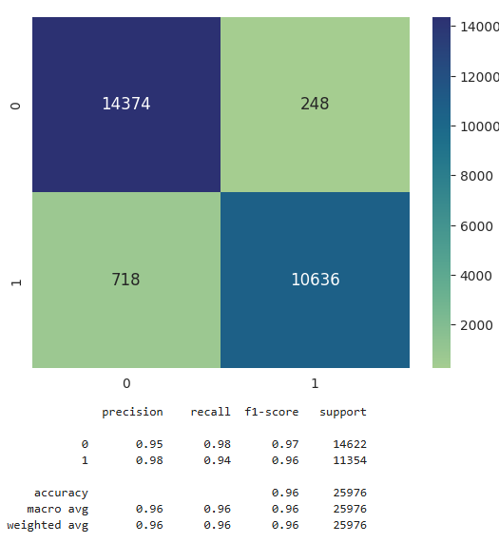
Random Forest
Definition: Random Forest is an ensemble learning method that constructs multiple decisiontrees during training. Each tree in the forest is trained on a random subset of the training data and arandom subset of the features.
During prediction, each tree in the forest independently makes a prediction, and thefinal prediction is determined by aggregating the predictions of all trees.
Random Forest is robust to overfitting and tends to generalize well to unseen datadue to the diversity of trees in the forest and the randomness introduced duringtraining.
Random Forest achieved the highest accuracy of 96.2%, indicating its strength in capturing the intricate patterns within the dataset.

Slide 17
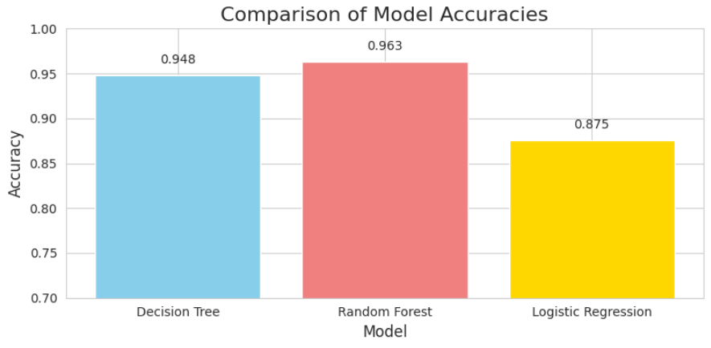
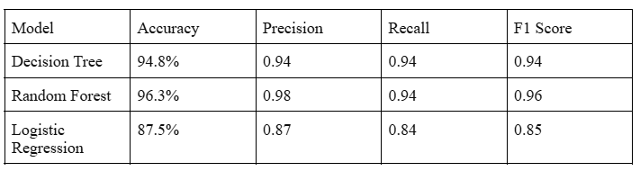
Results
1.The experimental results highlight Random Forest as the most accurate and reliable model for predicting airline customer satisfaction in this dataset.
2.The Decision Tree model provides comparable insights with added interpretability, making it useful for feature analysis.

Slide 18
Summary of Paper 1-The adverse impact of flight delays on passenger satisfaction: An innovative prediction model utilizing​ wide & deep learning​
Methodology:
Through an examination of the interplay between individual in-flight services and passenger characteristics utilizing the Pearson correlation coefficient and PCA-K-means clustering methods. From this analysis, a novel satisfaction prediction model is introduced, leveraging the Wide & Deep learning algorithm(jointly trains wide linear models and deep neural networks to combine the benefits of memorization and generalization for real-world recommender system).​
Pearson Correlation Analysis:Using heat maps, the correlation between 23 features in the dataset was visualized. The analysis revealed significant correlations, indicating interdependencies among attributes. For example, a strong negative correlation was observed between trip type and cabin class, suggesting that business travelers tend to choose higher-class accommodations. Further, a positive correlation was identified between inflight Wi-Fi service and ease of online booking, indicating that better Wi-Fi enhances the booking experience. Understanding these relationships is crucial for developing an effective satisfaction prediction model.​
Passenger Characteristics Analysis:Recognizing the varied impacts of individual passenger characteristics on satisfaction, the study employed Principal Component Analysis (PCA) combined with K-means clustering to analyze passenger data. This approach identified key variables while simplifying data visualization.​

Slide 19
The clustering results categorized passengers into four distinct types, highlighting the relationship between passenger characteristics and satisfaction outcomes:​
● Category A: Predominantly youth, high satisfaction for inflight entertainment and cleanliness, but lower scores for online boarding and seat comfort.​
● Category B: Middle-aged and elderly, moderate satisfaction with seat comfort but higher expectations for entertainment and online boarding.​
● Category C: Adolescents and youth, indicating high demands for convenience,comfort, cleanliness, and entertainment.​
● Category D: Middle-aged passengers showing higher satisfaction post-delay, though with varying evaluations of online boarding convenience.​
Experimental Environment​
● Dataset includes 129,880 samples, split into training, validation, and test sets in an 8:1:1 ratio.​
Performance Comparison​
● The Wide & Deep model achieved the highest performance metrics: accuracy (0.929), precision (0.945), recall (0.913) and F1 (0.929).​

Slide 20
Advantages:​
● Enhanced Accuracy: The model provides more precise predictions than traditional machine learning methods.​
● In-depth Analysis: Techniques like Pearson correlation and PCA-K-means clustering help uncover complex patterns in passenger data.​
​
Disadvantages:​
● Data Quality: Incomplete or poor-quality data can reduce prediction accuracy.​
● Complexity: The model's computational demands may be a barrier for some airlines.​
● Overfitting Risk: The model might perform well on training data but struggle with new data.​

Slide 21
Summary of Paper 2- Investigating Airline Passenger Satisfaction Using Data Mining Methods
Methodology:
1.Data Collection and Preparation:
Data sourced from Kaggle, including demographics, service ratings, and flight details.
Satisfaction categorized into two classes: satisfied vs. neutral/dissatisfied.
Data cleaning ensured a complete dataset of 129,487 samples, removing missing values.
Attribute relationships were assessed using correlation analysis and visualized with histograms and kernel density plots.
2.Feature Selection:
Forward selection (wrapper-based method) identified the top five features:
Online Boarding: Most critical for convenience and efficiency.
Inflight Wi-Fi Service: High demand for connectivity.
Baggage Handling: Reliability matters to passengers.
Inflight Entertainment: Key for long-haul travel satisfaction.
Type of Travel: Business travel significantly influences satisfaction segmentation.
A 10-fold cross-validation approach was employed to ensure robust and unbiased model evaluation. This method reduces sample variability and avoids overfitting, providing reliable performance metrics.

Slide 22
3. Machine Learning Models:
Ten supervised algorithms evaluated:
Decision Tree, Random Forest, Gradient Boosted Tree, k-NN, Naïve Bayes, Logistic Regression, Rule Induction, Neural Net, Deep Learning, and SVM.
Models were trained using all features and re-evaluated using the top five selected features.
Key Findings
Performance of Models:
Deep Learning was the top performer with:
Accuracy: 95.42%
F1-Score: 95.99%
ROC-AUC: 0.992
Neural Networks and Random Forests also demonstrated high predictive power.
Impact of Feature Selection:
Using only the top five features yielded strong results, confirming their importance in predicting satisfaction.
Even with reduced features, Deep Learning remained the best-performing model.
Importance of Features:
Online boarding, inflight Wi-Fi, baggage handling, and inflight entertainment are pivotal for satisfaction.

Slide 23
Advantages:
Improved Predictive Accuracy: Focused on relevant features, enhancing model accuracy and reducing noise.
Model Reliability: Cross-validation minimized overfitting, ensuring generalizability.
Comparative Analysis: Testing multiple models identified the most effective algorithm.
Disadvantages:
Computational Intensity: Feature selection was time-consuming and resource-heavy.
Resource Demands: Cross-validation, especially for deep learning, required significant resources.
Increased Complexity: Testing multiple models extended processing time and complexity.
Conclusion:
The study showcases the value of data mining and machine learning in understanding passenger satisfaction. Key insights—improving online/mobile boarding, inflight Wi-Fi, baggage handling, and entertainment—offer actionable strategies for airlines to boost satisfaction, loyalty, and competitive edge.

Slide 24
Conclusion
This project successfully developed a predictive model for airline customer satisfaction using various machine learning techniques. After evaluating multiple models, Random Forest emerged as the best-performing model, achieving an accuracy of 96.2%. This high accuracy underscores the model’s ability to capture complex relationships and interactions between features that influence customer satisfaction. The analysis highlighted key satisfaction drivers, such as travel class, customer loyalty, and service quality (e.g., inflight entertainment, seat comfort, and punctuality). These insights provide valuable guidance for airlines aiming to enhance customer experiences by focusing on areas that directly impact satisfaction.

Slide 25
References
[1]Cen Song , Xiaoqian Ma , Catherine Ardizzone , Jun Zhuang(2024). The adverse impact of flight delays on passenger satisfaction: An innovative prediction model utilizing wide & deep learning.https://www.sciencedirect.com/science/article/pii/S0969699723001540
[2]Tri Noviantoro, Jen-Peng Huang(2018). Investigating airline passenger satisfaction: Data mining method:https://www.sciencedirect.com/science/article/pii/S2210539521001097
[3]Dataset:https://www.kaggle.com/datasets/teejmahal20/airline-passenger-satisfaction
[4]https://www.geeksforgeeks.org/random-forest-classifier-using-scikit-learn/

